Slide 1


Windows Azure
Integration for Windows Store Apps
Joachim Leonfellner

Slide 2
Goal
Extend existing Windows Store App
Create Windows Azure Account
Add Mobile Service
Connect Service to Visual Studio Solution
Store App-Data in Windows Azure

Slide 3
Sign-Up for Windows Azure
http://www.windowsazure.com
Create a free trial account
Login

Slide 4
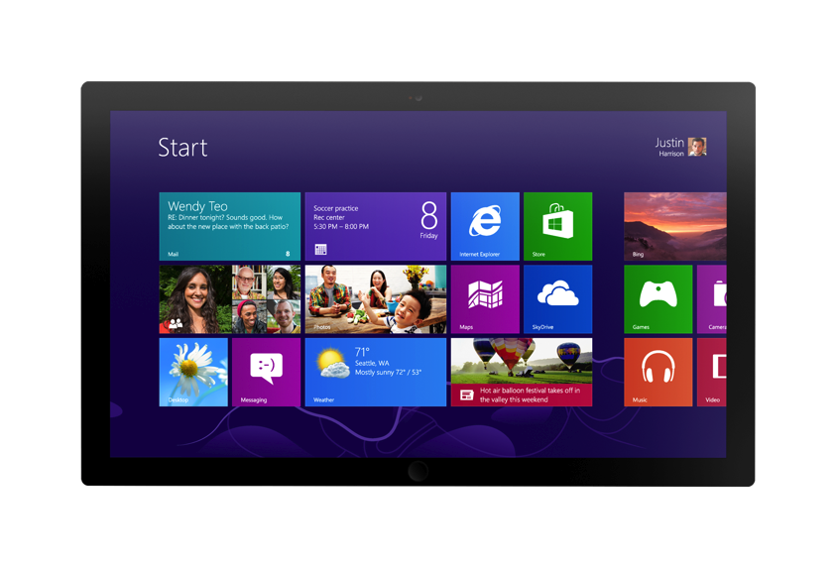
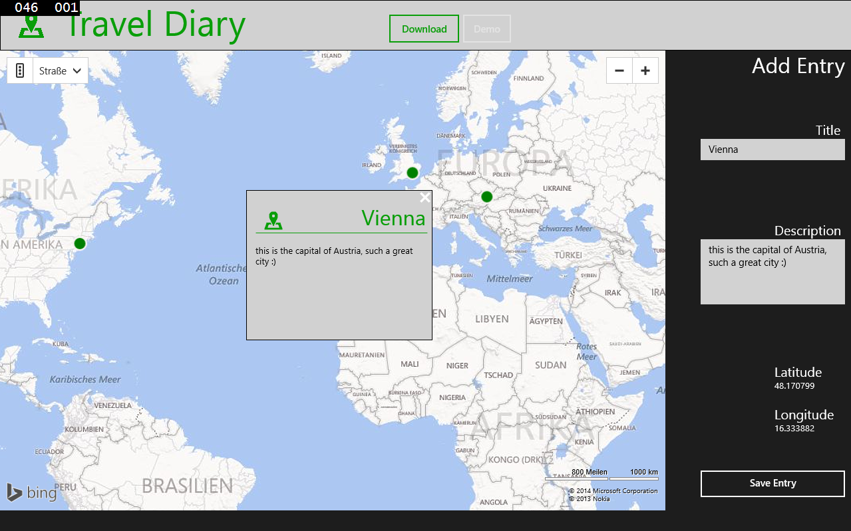
Overview
Travel Diary
Read and add diary entries
Show all entries on a map
Store diary in Windows Azure

Slide 5
Demo Travel Diary

Slide 6
Add new Mobile Service
Link Azure Subscription to App
Download the subscription file
https://windows.azure.com/download/publishprofile.aspx
Import into Visual Studio
Add connected service to solution

Slide 7
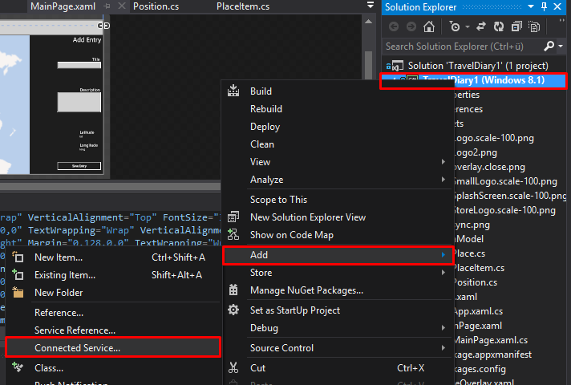

Slide 8
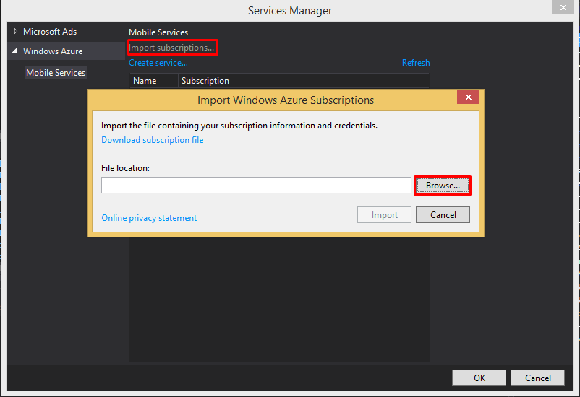

Slide 9
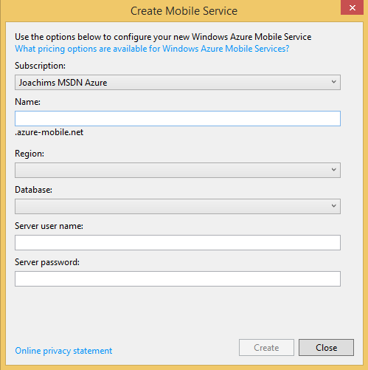

Slide 10
MobileServiceClient
MobileServiceClient xxxClient = new MobileServiceClient
(
"https://XXXXXX.azure-mobile.net/",
“123456789“
);

Slide 11
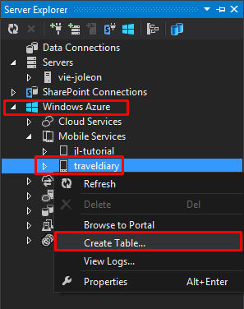
Add table for data storage

Slide 12
Working with data from Azure
Access data table
Get table content
IMobileServiceTable<xxx> xxxTable = App.traveldiaryClient.GetTable<xxx>();
private async Task<List<xxx>> GetListAsync()
{
return await xxxTable.ToListAsync();
}

Slide 13
Working with data from Azure
Map properties to data table
Write data to table
[JsonProperty(PropertyName = “xxx")]
private async void InsertDataAsync(XXX x)
{
await xxxTable.InsertAsync(x);
}

Slide 14
Demo Travel Diary

Slide 15
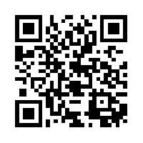

Resources
http://aka.ms/jquery2014
© 2013 Microsoft Corporation. All rights reserved. Microsoft, Windows, Windows Vista and other product names are or may be registered trademarks and/or trademarks in the U.S. and/or other countries.
The information herein is for informational purposes only and represents the current view of Microsoft Corporation as of the date of this presentation. Because Microsoft must respond to changing market conditions, it should not be interpreted to be a commitment on the part of Microsoft, and Microsoft cannot guarantee the accuracy of any information provided after the date of this presentation. MICROSOFT MAKES NO WARRANTIES, EXPRESS, IMPLIED OR STATUTORY, AS TO THE INFORMATION IN THIS PRESENTATION.

